Slide 1
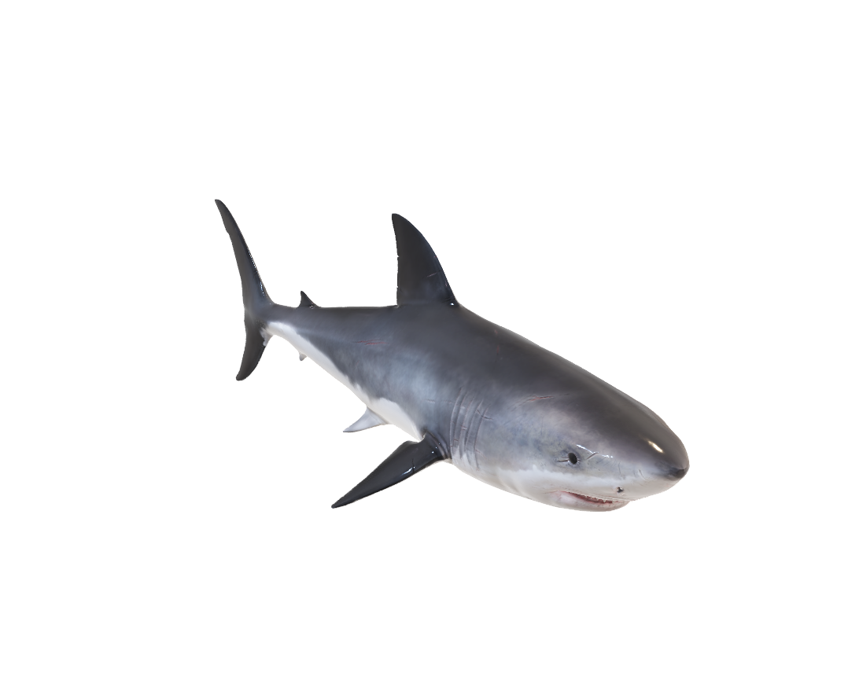
GREAT WHITE SHARK
The Great White Shark (Carcharodon carcharias) is the world's largest predatory fish, known for its powerful, torpedo-shaped body, grey-brown top, white underside (countershading), and rows of serrated teeth, growing over 20 feet and weighing thousands of pounds.

Slide 2
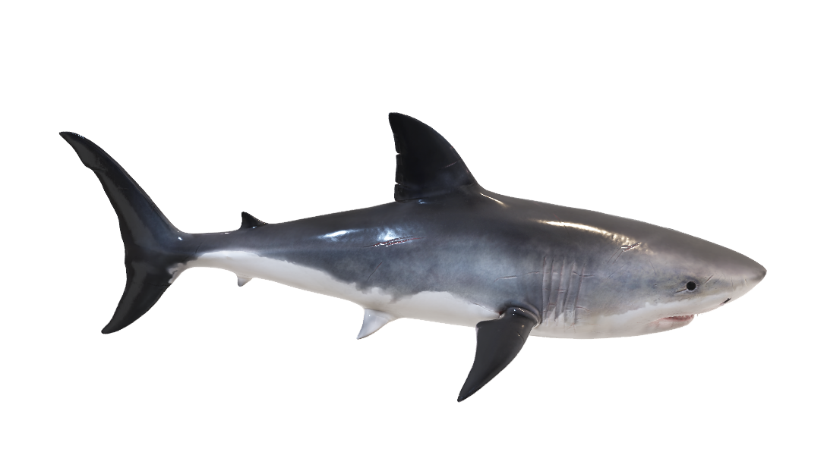
GREAT WHITE SHARK

Slide 3
GREAT WHITE SHARK

Slide 4



Slide 5
